Slide 1

Group 1: Program Demo
Ethan, Girish, Rian, Yinus

Slide 2

The smart food ordering interface
•In response to the ever-evolving demands of the modern world, our team developed a cutting-edge solution— a Smart Food Ordering Interface. Recognizing the need for an efficient, seamless, and time-saving approach to food ordering, our project aimed to revolutionize the way customers interact with menus and place orders.

Slide 3

Goal
The primary goal of our Smart Food Ordering Interface is to streamline the food ordering process for customers, ensuring a quick and hassle-free experience. By providing an intuitive interface, customers will have the ability to effortlessly browse through the menu, select their desired dishes, and add them to their virtual cart. The ordering process will be optimized for speed and accuracy, reducing the likelihood of miscommunication and errors in orders.

Slide 4
MAJOR FEATURES
Intuitive Menu Browsing: Customers can easily explore the menu, categorized for convenience, ensuring a user-friendly experience.
1
Efficient Dish Selection: The interface facilitates swift dish selection, allowing users to add items to their cart with a single click.
2
Quick Order Placement: The streamlined interface accelerates the order placement process, minimizing delays.
3

Slide 5
Benefits
•Time Efficiency: Customers save valuable time by swiftly navigating the menu and placing orders, reducing wait times and enhancing overall efficiency.
•Accuracy: With a digital ordering system, the chances of miscommunication are significantly diminished, leading to more accurate order fulfillment.
•Enhanced User Experience: The user-friendly interface ensures a positive and enjoyable experience for customers, fostering customer satisfaction and loyalty.
•Adaptability: The system is adaptable to various dining scenarios, whether in a restaurant, café, or for takeaway, catering to diverse customer needs.

Slide 6
Integration Tests

Slide 7
Integration Tests
Increment Button Test
Decrement Button Test
Update Status Test
Integration of Chef and ChefTableView
Call Server Button Test
6. Integration of Watier and WaiterTableView
7. Integration of LoginPage and WaiterTableView
8. Integration of LoginPage and ChefTableView
9. Integration of TableView and MainMenu page

Slide 8
Screen Share and Run the test case

Slide 9
Usability Tests

Slide 10
Usability Tests
Verification_Test
Clarity_Test
Evaluation_Test
Feedback_Test
Login_Test
Order_Sent_Test
Order_Update_Test
Confirm_Bill_Test
9. Request_Help_Test
10. View_Request_Help_Test
11. Status_from_Chef_Test
12. Table Order Notification
13. Waiter Table Order Display
14. Waiter Dish Status Update
15. Understand_MenuLayout_Test
16. Navigation_Test

Slide 11
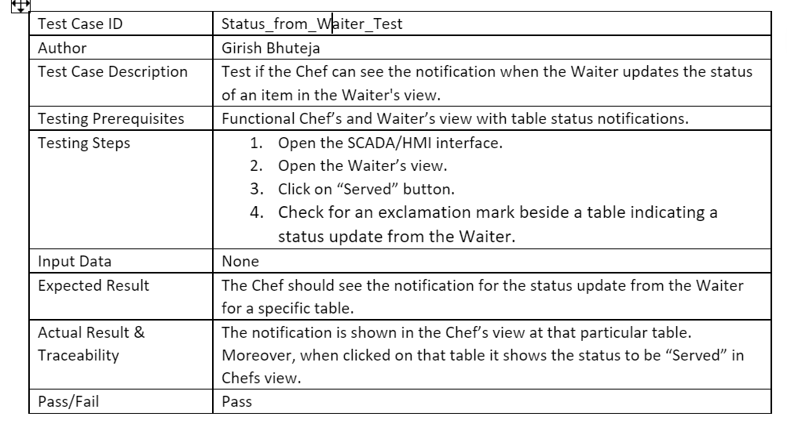
Status Update

Slide 12
Screen Share and Run the test case

Slide 13
Issues and Lessons
A retrospective of the Development of our Project

Slide 14
Main Topics
Issues
Lessons
Usage of unfamiliar software
Incomplete / Partial Design Phase
Time Management
GitHub Repository Issues
Proper Conduct for Designing
Formatting communication between modules
Adhere to known technology
Play to your skills

Slide 15
Issues Unfamiliar Software and Partial Design
An important aspect of the designing phase of SDLC is identifying the tools to be used.
Taking the time to learn and understand unfamiliar tools.
Practice their usage before implementing them.
Result: Extreme difficulty in the creation of GUI, and increased time spent
The design phase was handled very poorly.
This became a problem when integrating and interweaving modules.
The coupling between modules was high.
Responsibility for coupled modules was split.

Slide 16
Time Management
GitHub Issues
While we had created a development plan, we found it difficult to follow it
In a Sprint, these issues would come up during the daily huddles.
We could not implement sprint ideology or planning
The GitHub is a version control and a repository to collect files
The repository itself is at odds with our IDE: Visual Studios
Visual Studio Program files would encounter problems when trying to commit.
Under-utilization of GitHub tools.
Notes:
Multiple times over the course of our programming, Visual Studio Program files would encounter problems when trying to integrate.

Slide 17
Lessons
Design Conduct
Module Communication
More time and consideration should be spent in this phase.
Pull from our teachings in another course to make this process easier
Properly map out the relationships and split the requirements
After tasks are divided and modules are created, sit down to flesh out the inter-module communication.
Data your modules will receive and send to accomplish the tasks
Makes Integration much smoother

Slide 18
Familiar Technology
Play to your Strengths
Where possible use familiar technology and languages.
Judge the time it’ll take to learn a new technology, vs. coding with familiar technology.
Work should be divided according to the strengths and abilities of each member.
If there are concepts or problems that a person is comfortable solving, they should be responsible for them.
Notes:
If the time to learn outweighs the time to code in familiar language is less then the time it would take to learn a new language, stick to what’s familiar

Slide 19
Concluding
Our program is functional and can satisfy most of the requirements in the beginning of our Programming.
The product can properly take orders, save the orders to files, and send the relevant information to staff data.
There were issues and hiccups during development. We take these failures and learn from them.
Our program aims to bridge the Customer Ordering, and Kitchen viewing of Orders.

Slide 20
The End
Any Questions?

